Slide 1
Working with DNA
Module 1: Introduction to DNA and the tools of biotechnology

Slide 2
What is DNA?
Module 1 Presentation A
Notes:
There are two presentations in the first module – presentation A and presentation B. Ideally, as you work through this presentation – presentation A – you should also have booklet A on hand to work through. You can write your notes and answers directly into a hard copy of booklet A, or if you don’t have booklet A printed, you can write directly into your own notebook.

Slide 3
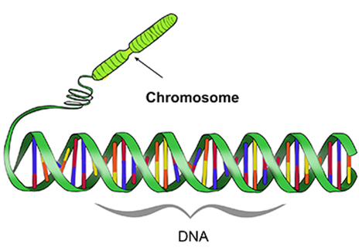
What is DNA?
Learning intention
Success criteria
Understand that DNA is a double-stranded molecule that contains genes.
Define the term “gene”
Recognize that the purpose of gene expression is to synthesise a functional gene product.
Identify differences and similarities between DNA in eukaryotes and prokaryotes

Slide 4
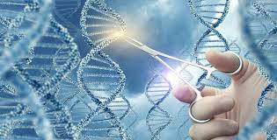
This is because…
DNA technologies are used in a range of industries; your body and your food are made of cells with DNA and protein.

Slide 5
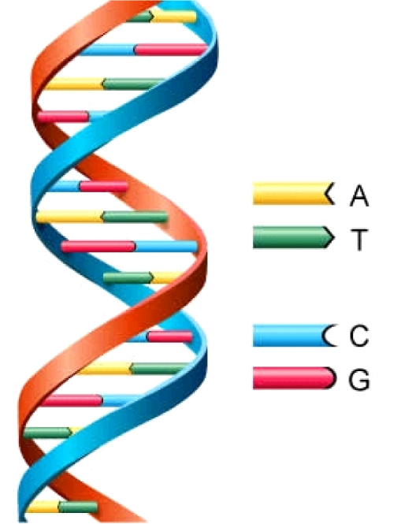
DNA Fast Five – True or False?
1. DNA is only found in animals
2. DNA can replicate to make copies of itself
3. DNA can be cut and pasted
4. Many viruses contain DNA
5. All DNA has the same overall structure

Slide 6
DNA Fast Five
1. DNA is only found in animals
False
2. DNA can replicate to make copies of itself
True
3. DNA can be cut and pasted
True
4. Many viruses contain DNA
True
5. All DNA has the same overall structure
True

Slide 7
What is DNA?
Watch this video on DNA.
DNA is a substance/molecule that contains a code to make proteins.
Proteins are the molecules of life. They catalyse reactions and make structures in your cells.
You can think of proteins as the “building blocks” and “workers” of cells – they ultimately affect an organism’s phenotypes.
DNA and proteins are found in cells of all living things: bacteria, algae, plants, animals etc.
https://commons.wikimedia.org/wiki/File:Central_Dogma_of_Molecular_Biochemistry_with_Enzymes.jpg

Slide 8
DNA → mRNA → to protein
DNA is a molecule that contains many sections called genes.
Gene
Gene
DNA
mRNA
Genes tell the cell to make protein.
protein
Do you know what these processes are called?

Slide 9
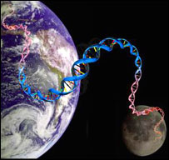
DNA Organisation
1 metre of DNA in just one human cell??
With trillions of cells in one human, your DNA would stretch to the moon and back…..
How can we fit all that DNA in our cells?

Slide 10
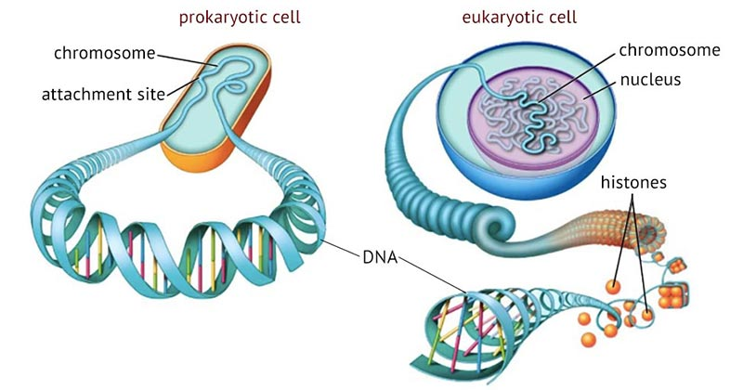
DNA is tightly wound into packages called chromosomes.
In eukaryotes, these are packed with histone proteins in the nucleus.
https://microbenotes.com/prokaryotic-and-eukaryotic-chromosomes/

Slide 11
What is DNA?
Complete page 3 of booklet A.

Slide 12
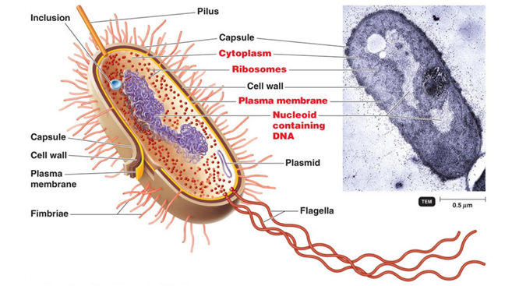
DNA in bacteria
Take notes on page 4 of booklet A.
https://glycopedia.eu/e-chapters/the-structure-of-bacterial-cell/article/main-features-of-the-bacterial
Notes:
Purple stuff in diagram = DNA

Slide 13
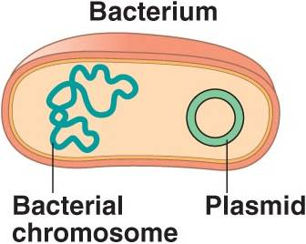
Bacterial Plasmids
Take notes on page 4 of booklet A.
These are small circular pieces of DNA that occur in bacteria. Bacterial cells can share plasmids between each other and therefore share genes.
Plasmids modified for biotechnology are now commercially available to buy.
We use them as DNA vectors.
A vector is something that can transport [a gene] from one organism to another.
Notes:
Another place you would have heard the word “vector” in biology before, is when studying diseases. In disease biology, a vector transports a pathogen from one host to another host. For example, mosquitoes are the vectors for transporting the malaria-causing parasite from host to host. In this case, a vector is a bacterial plasmid that transports a gene from one organism to another.

Slide 14
Bacterial Plasmids
Take notes on page 4 of booklet A.
Figure 1: A diagram of a bacterium (a single cell), containing a regular chromosome and plasmids.
Notes:
How many plasmids are shown? What do you notice about how the genomes are drawn? With TWO lines.. DNA is double stranded.

Slide 15
Statements About DNA
Complete the Venn diagram on page 5 of booklet A.
From the statements below, identify whether they apply to prokaryotes, eukaryotes, or both. Place each statement in the correct position on a Venn Diagram (p 5 of booklet).
Double stranded helix
Made of sugar-phosphate backbone with base-pairs
Found in the nucleus
Found in the cytoplasm
Can be a circular plasmid
Transcription occurs in the cytoplasm
Translation occurs in the cytoplasm
Genes are the units that code for proteins

Slide 16
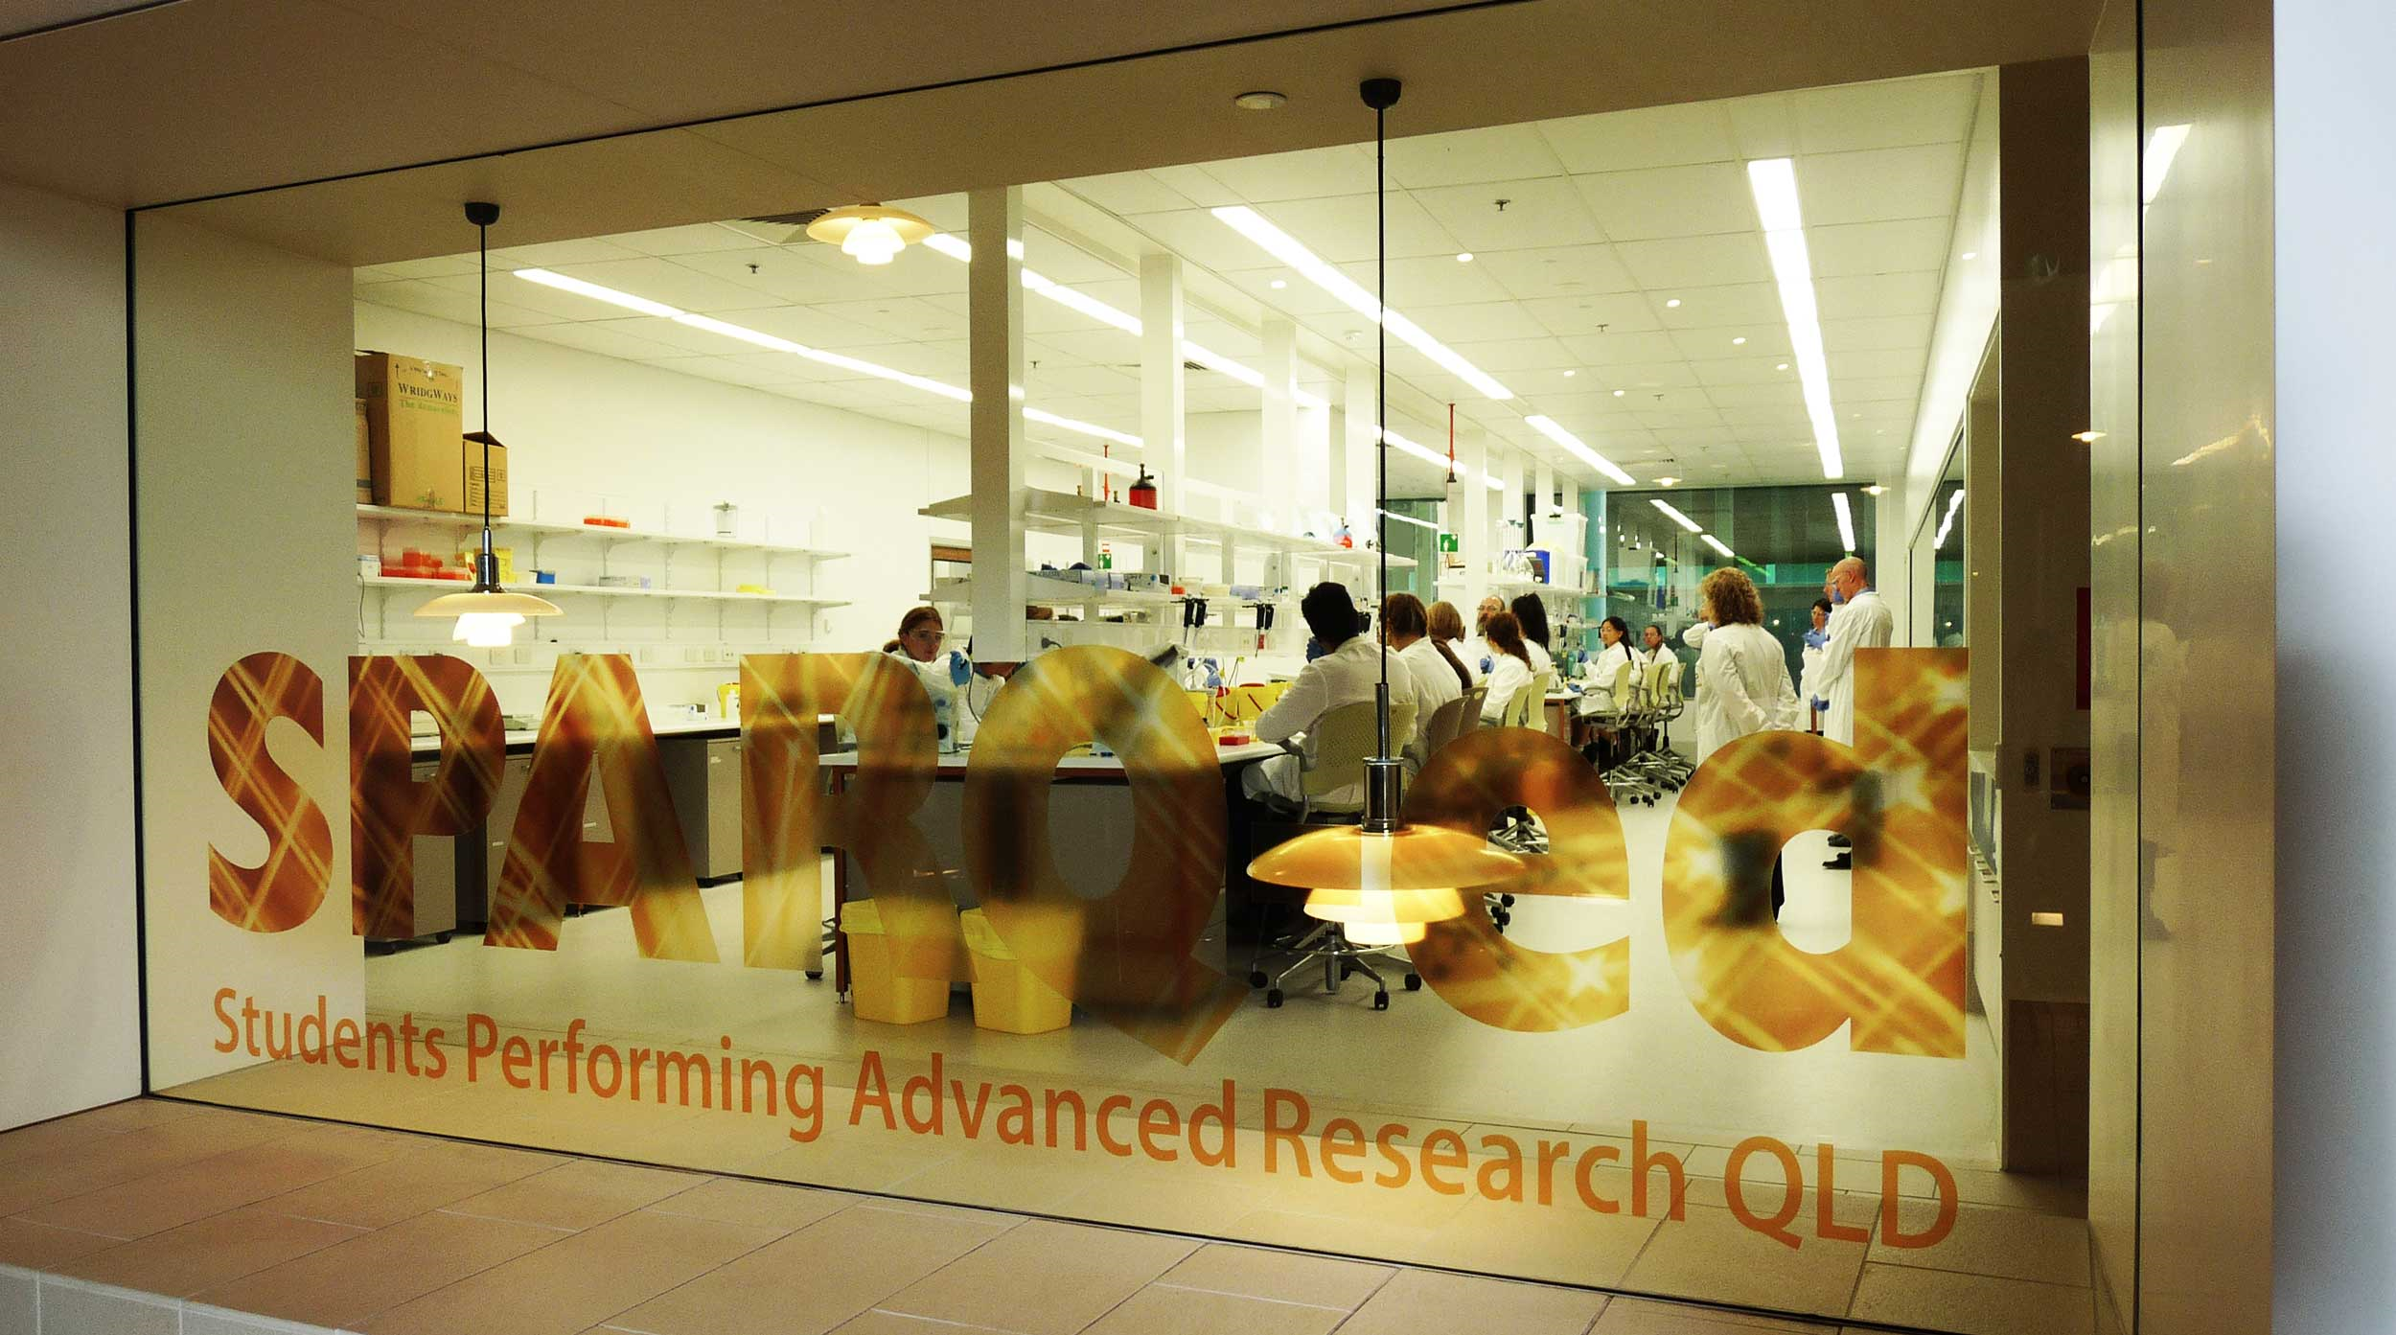
Thank you!
https://di.uq.edu.au/sparq-ed
sparqed@uq.edu.au

